Slide 1


Slide 2
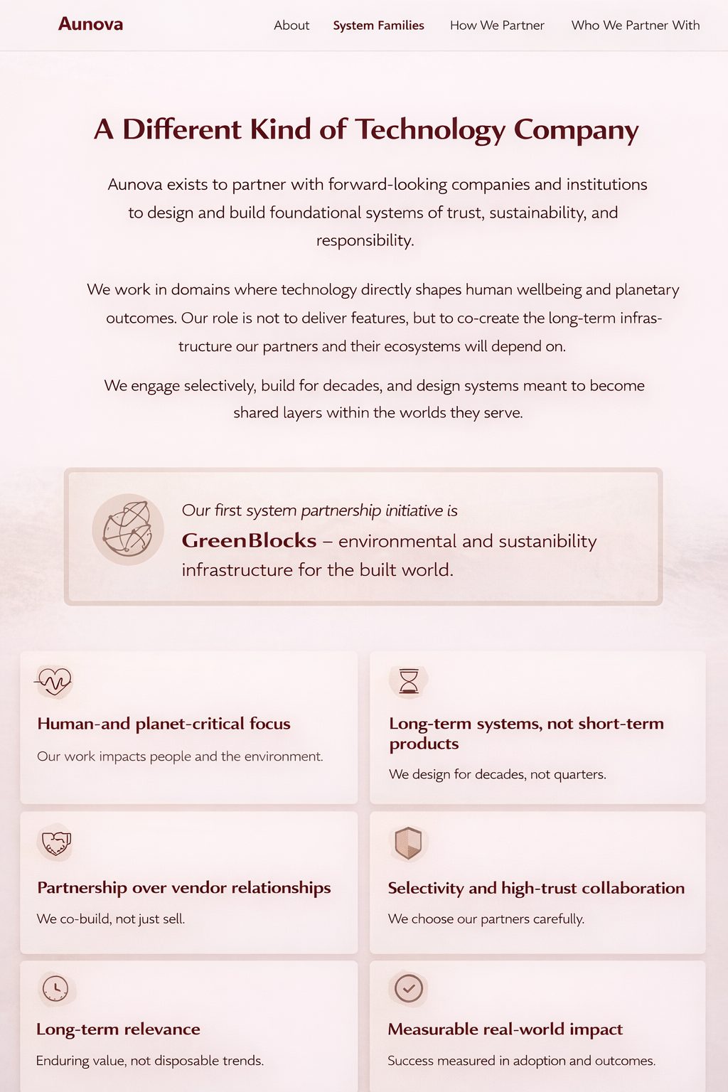
ABOUT
Section 2 A Different Kind of Technology Company

Slide 3
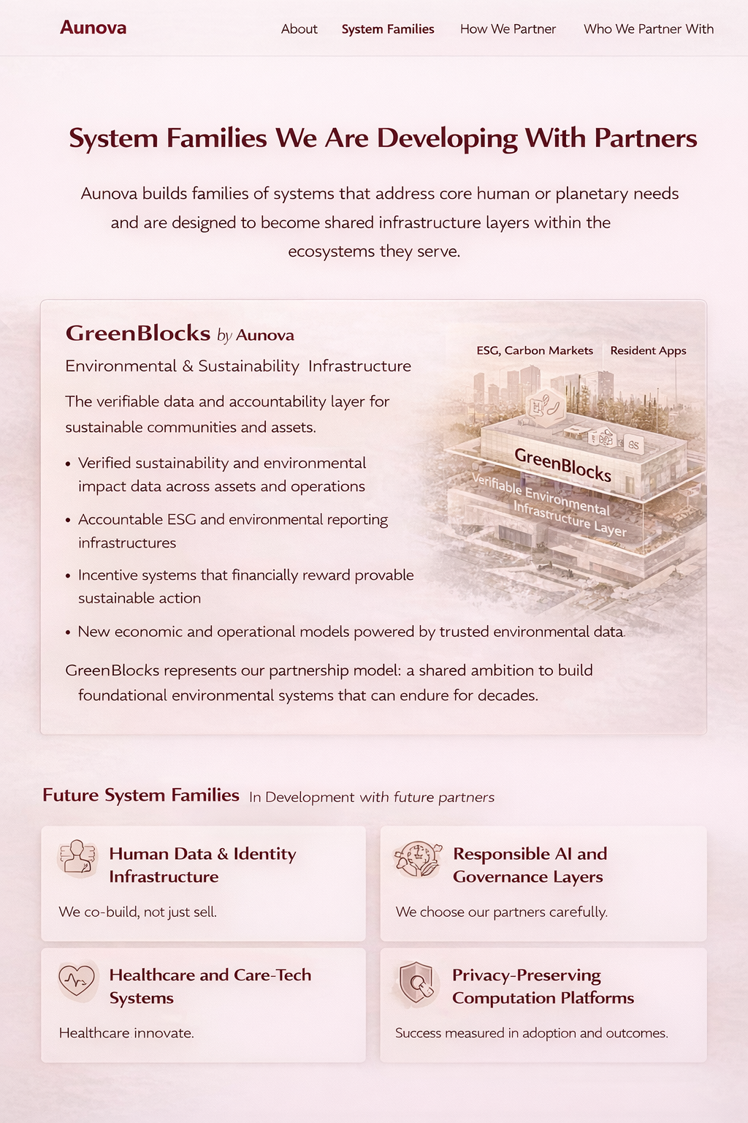
SYSTEM FAMILIES
Section 3 System Families

Slide 4
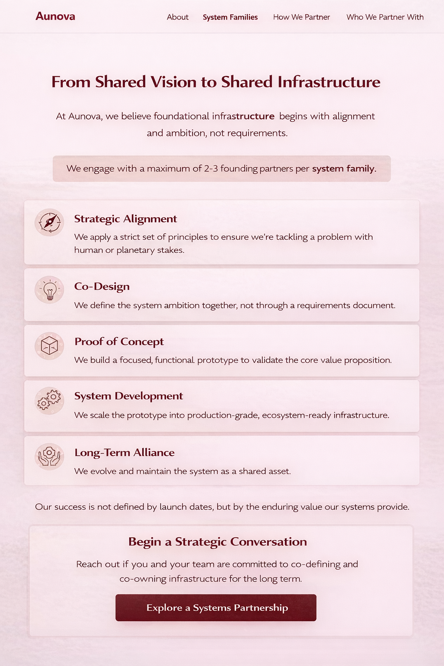
HOW WE PARTNER
Section 4 How We Partner

Slide 5
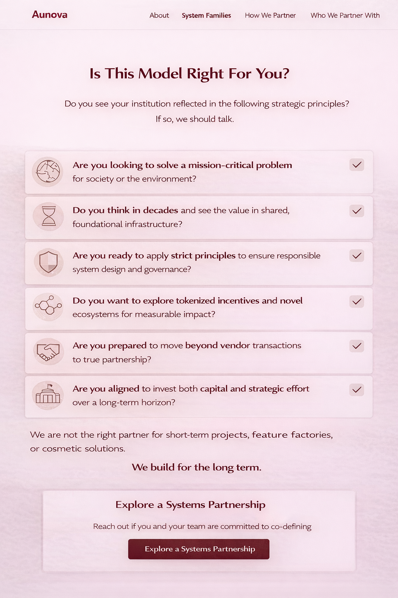
WHO WE PARTNER WITH
Section 5 Who We Partner With

Slide 6
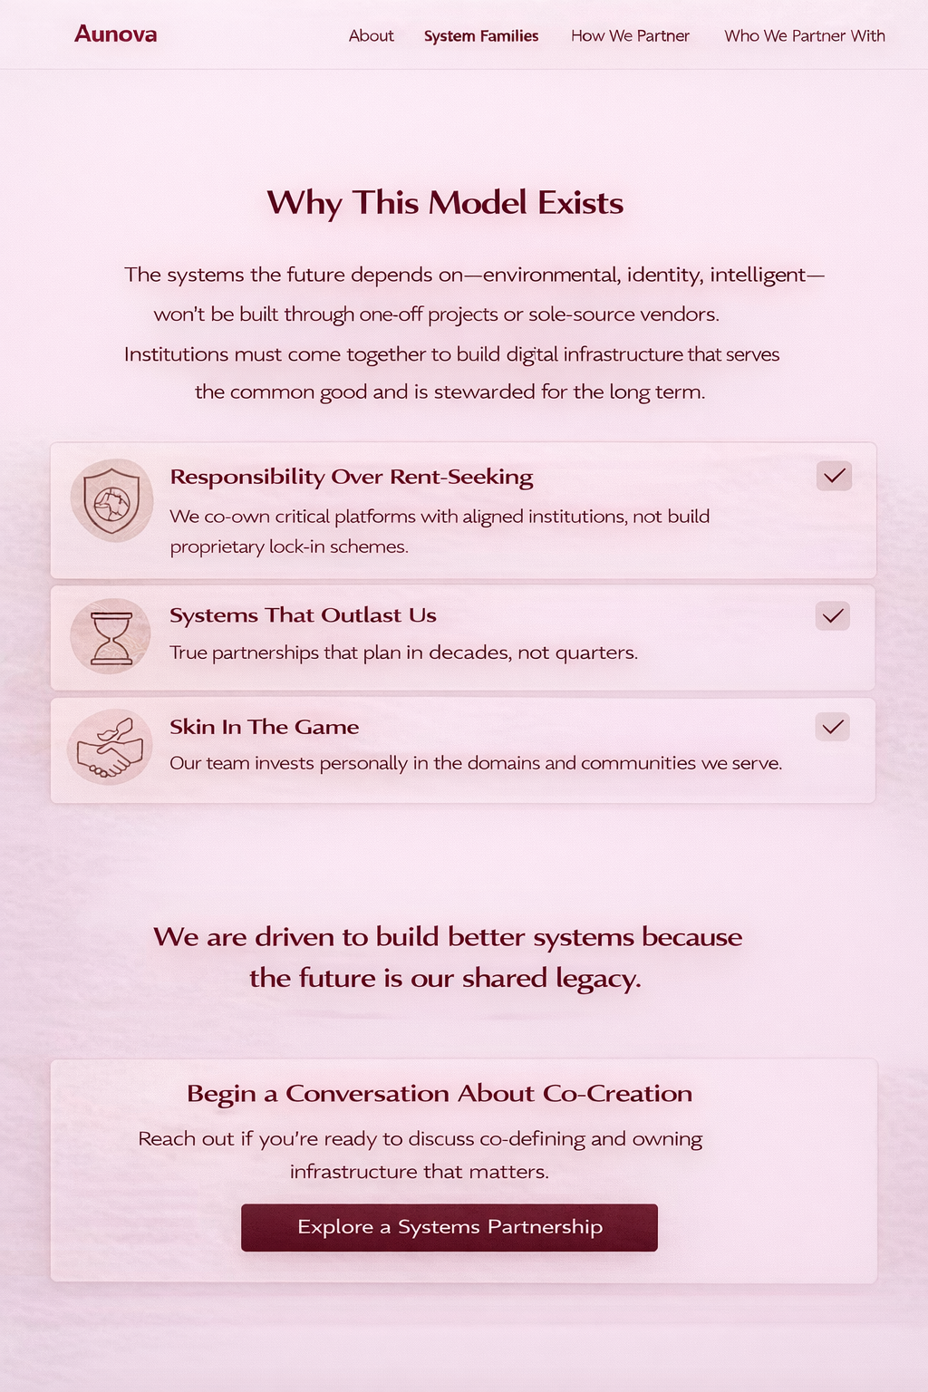
WHY AUNOVA EXISTS
Section 6 Why Aunova Exists

Slide 7
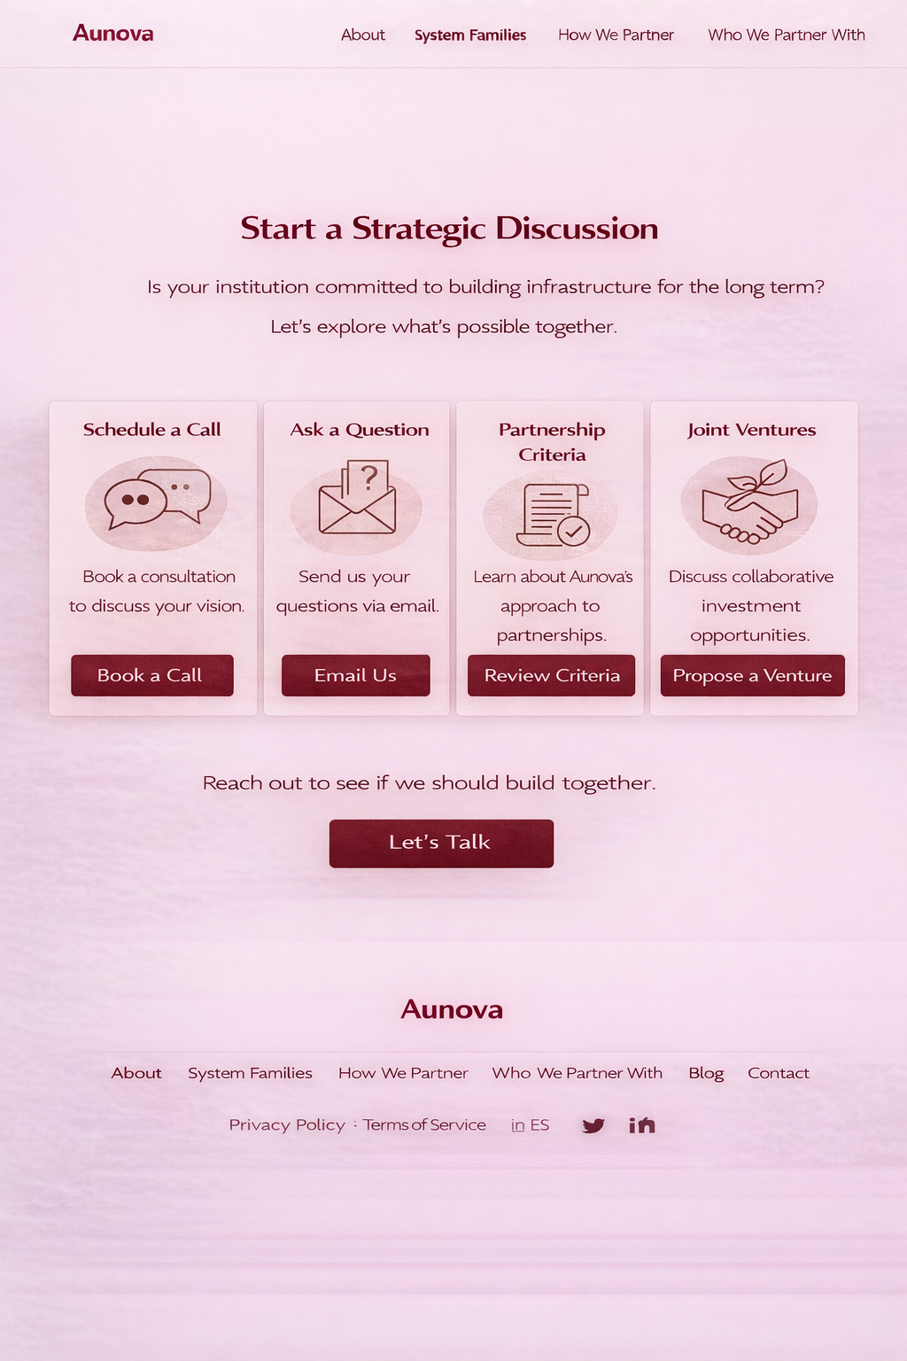
BEGING A STRATEGIC CONVERSATION
Section 7 Begin a Strategic Conversation

